Slide 1
Propagating
Softwood Cuttings
Mitchie & John Moe
Master Rosarians
Pacific Northwest District
American Rose Society
Revised June 2021
January 11, 2012

Slide 2
Acknowledgements
We appreciate the efforts of the following rosarian, nurseryman and fellow hybridizer who contributed the basic procedure for this presentation;
All photos by authors, except where credits are given
Steve McCulloch
Owner, Mountain Shadow Nursery
Past President, International Plant Propagator’s Association
Consultant – Rose Hybridizers Association

Slide 3
To Propagate
The definition of propagation is to create a new plant that is identical to the original plant.

Slide 4
U.S. Plant Patent Act
Under the law, the grant of a patent includes the “right to exclude others from asexually reproducing the plant or selling or using the plant so reproduced.” Infringement of the patent includes the propagation or sale of a single patented rose, whether for sale or private use without permission.

Slide 5
Propagation
The multiplication or reproduction of a kind or species
Via
Sexual methods
Asexual methods

Slide 6
Sexual Propagation
From seeds
Transfer of pollen from the anther of one rose to the stigma of another – this is the hybridization process
  Fertilization occurs and seeds are produced

Slide 7
Asexual Reproduction
Uses growing plant parts other than the seeds
Types of asexual reproduction
    Cuttings
    Layering
    Division or separation
    Budding
    Grafting
    Tissue culture

Slide 8
Cuttings - Defined
Any detached plant part which, when grown under favorable conditions, will produce a new plant identical to the parent plant
Types of cuttings
Root
Leaf
Stem
We will be discussing stem cuttings in this program

Slide 9
Stem Cuttings
One of the simplest methods of propagating new roses is to cut off pieces of the stem and plant them into a growing medium, where they will take root
There are two different methods;
  Hardwood – taken in late fall or early winter
  Softwood – taken during the growing season
Let’s talk about some softwood cuttings today!
Note: The ‘baggie’ method we will describe is probably the easiest way to propagate softwood cuttings on a small scale, as it provides the humid growing environment necessary for root and new leaf growth.

Slide 10



Let’s look at how to make more of these lovelies!
Seattle Sunrise
Photo by Rich Baer
Lynn
Photo by Corinne Brown
Hot To Trot

Slide 11
Gather Materials
Your cuttings
Containers or cut down milk cartons
Plant starter rooting cubes – we did use floral foam, but now use Root Riot ® cubes
Sterile potting mix – we prefer Sunshine #4
Rooting hormone – many brands available, liquid, powdered or gel - we prefer Clonex ® gel
Labels or tags, cup and spoon, sharp pruners
Plastic bag (milky kind) & support sticks
Other coverings as needed
Water
Note: The following slides depict the propagation of minis and minifloras. The procedure for HT’s and other large roses would be exactly the same, but with larger cuttings of approximately pencil diameter.

Slide 12
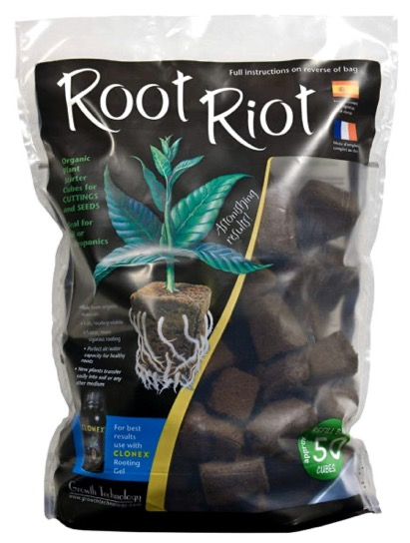
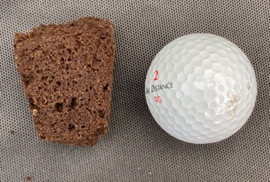
Plant Starter Cubes
Made of fine grade Canadian peat moss
They are pH balanced and pre-moistened
They have a spongy texture that provides the ideal air to water ratio and allows them to maintain a consistent moisture level
They are specially inoculated with micro- nutrients and growth hormones to nourish young plants and aid in rapid root development
Here you can see their size

Slide 13
Some Technical Stuff
Most plant cuttings will produce their own rooting hormones in time. Many clone easily by placing them in clean water
Others may take a long time to develop roots without the use of a rooting hormone
Auxin is a plant hormone that aids in the initiation of roots to grow in unusual places, e.g., from the stem. Indole acetic acid (IAA) is naturally occurring in plants. Some plants don’t produce enuf auxin and are difficult to root. So, we help!
Most rooting products do not contain IAA but rather a synthetic form of indole butyric acid (IBA) which is more effective in rooting than IAA

Slide 14
Rooting Hormone
Synthetic forms include powder (Rootone ®, Hormodin ®, etc.), liquid (Dip ‘N Grow ®, etc.) or gels such as Clonex ®, etc.
Naturally occurring hormones include;
  Willow extract contains two auxin hormones found in high concentration in the growing tips of the branches – works quite well
  Honey protects the tender cuttings from pathogens and allows the natural rooting hormones to work

Slide 15
Using a Rooting Hormone
With all synthetics – put a small amount for use into a separate container to avoid contamination of the entire supply
Liquid forms can be ready-to-use or concentrated. Do as above with the ready-to-use, while the concentrated requires dilution, so it is made in a separate container
Gels have an advantage – they help seal the cut plant tissue and promote new root growth

Slide 16
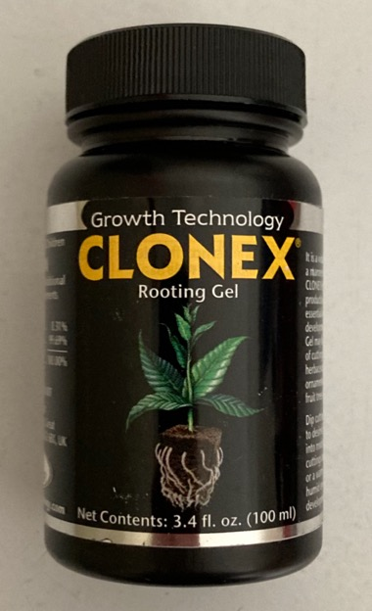
A Gel Hormone We Use
Clonex ® Rooting Gel encourages rapid root development while helping to minimize plant stress
It will remain in contact around the stem, actually sealing the cut tissue and then supplying the hormones needed to promote root cell development
It is registered with the EPA and is approved for use on all food crops, including medicinal plants

Slide 17
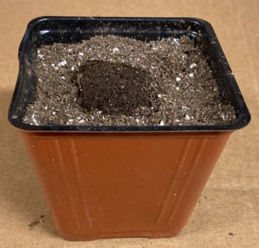
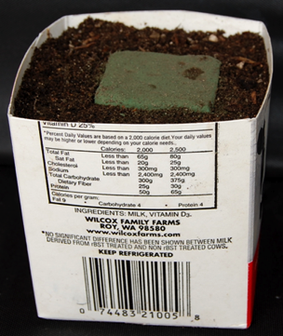
Preparing Growing Container
Use container or ½ milk carton For carton, punch holes in bottom for drainage
Put rooting medium in bottom so top of rooting cube will be just below top of container
Insert rooting cube
Fill container around rooting cube with rooting mix and water well
Repeat for each cutting
Note – this ½ milk carton still has floral foam

Slide 18
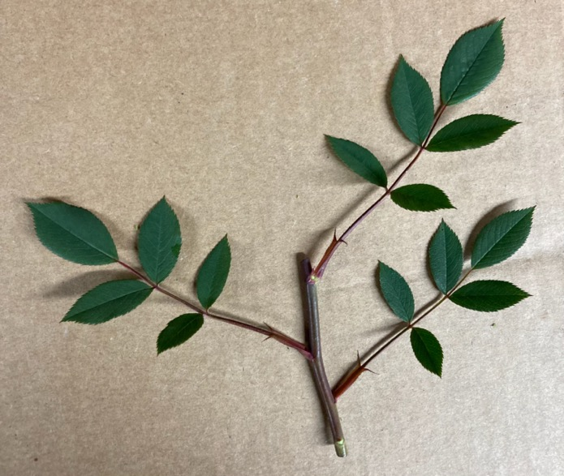
Taking Cuttings
Take cuttings from healthy plants during morning hours when they’re well hydrated
Select a cutting that has three sets of leaves
Remove the bloom, cut at a 45-degree angle just above the top set of leaves
Condition – recut under water - keep moist at all times!
Put a label/tag to ID

Slide 19
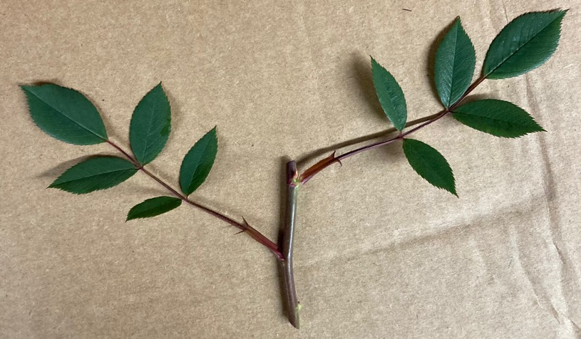
Preparing the Cutting
eye
Break off any prickles (thorns) that will be down in the rooting cube
Remove the lower set of leaves leaving two sets
Make a 45-degree cut just below the bottom eye
Wound (scrape) lightly the stem opposite of the bottom eye
Roots will form from the wounded area

Slide 20
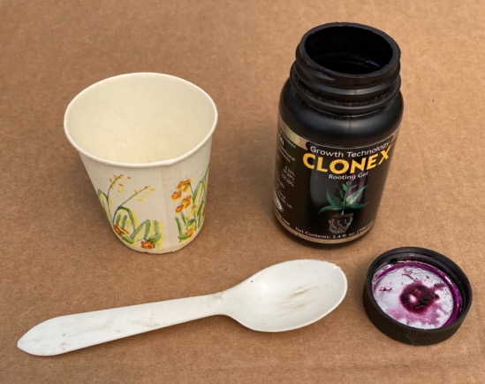
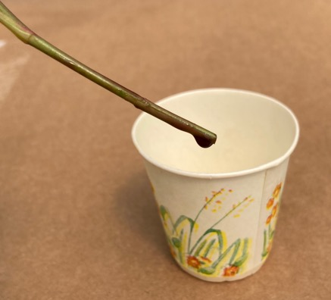
Using Rooting Hormone
Dip stem in cup, not in jar!
Discard leftover rooting hormone when finished with all cuttings
Put a small amount of rooting hormone in a small cup

Slide 21
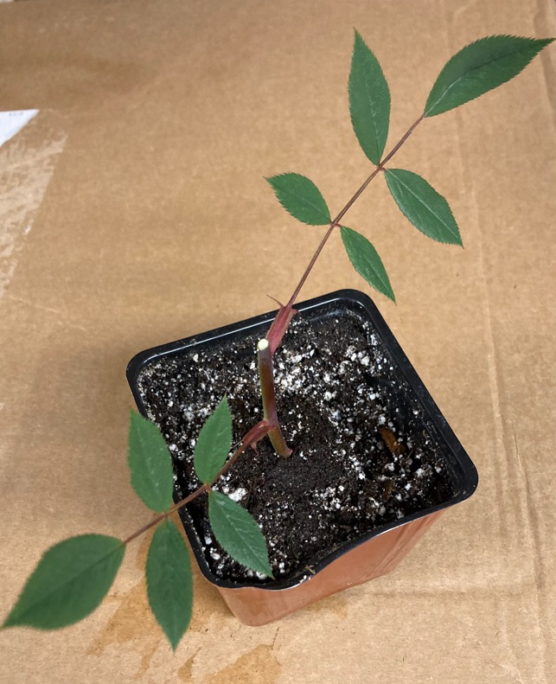
Sticking the Cutting
Gently insert cutting into the rooting cube, just far enuf so it is supported
Don’t push the stem down thru the bottom of the rooting cube

Slide 22
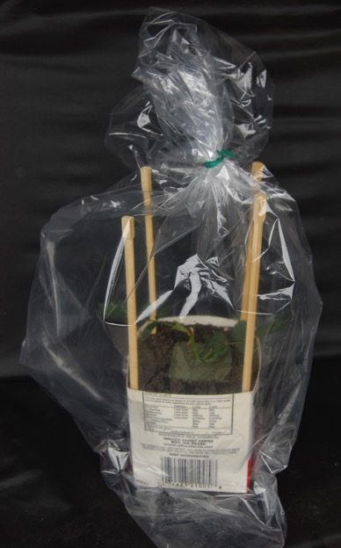
Bagging the Cutting
Use white (milky) bag, not clear!
Insert sticks in corners of the container to keep bag from collapsing
Label with variety name and date
Place cutting in bag and mist with a fine spray
Close bag with rubber band or twist tie
Note: Clear bag shown for clarity on this drawing only!
This is a NO-NO!

Slide 23
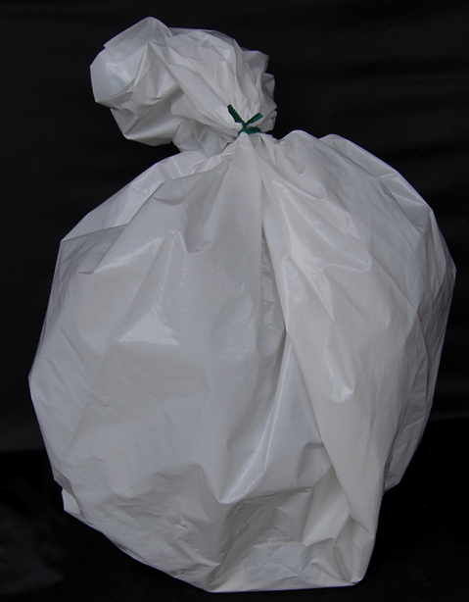
Care of the Cutting
Place bag in a semi-shaded area out of direct sunlight
Open bag every few days to ventilate
Remove fallen or diseased leaves
Mist leaves lightly and close bag – don’t overdo the misting!
The condensation inside the bag will provide most of the moisture the cutting needs
This is the right kind of bag!

Slide 24
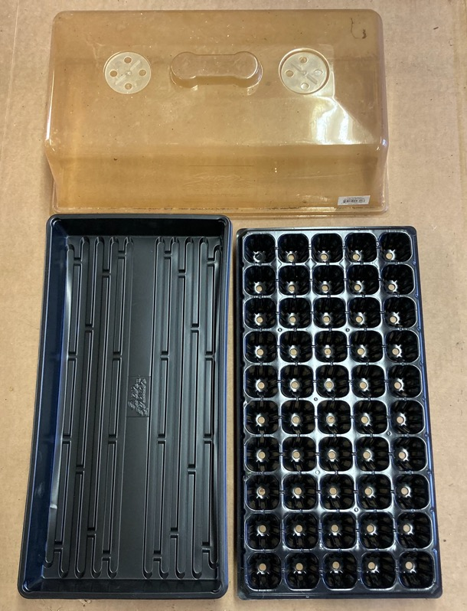
If Propagating a Large Number of Cuttings
You might consider using something like this
This set is called “Super Sprouter”
Consists of a 1020 tray, a 50 cell insert that works well with the Root Riot cubes and a humidity dome

Slide 25
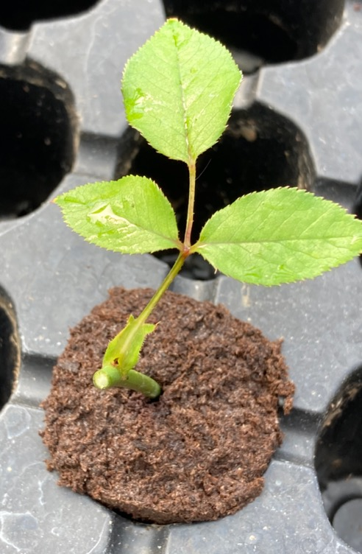
Sticking the Cutting
Insert “Root Riot” cube for each cutting in the 1020 tray insert as shown
Prepare cutting as described for the “baggie” method
Gently insert cutting into the rooting cube, just far enuf so it is supported
Don’t push the stem down thru the bottom of the rooting cube

Slide 26
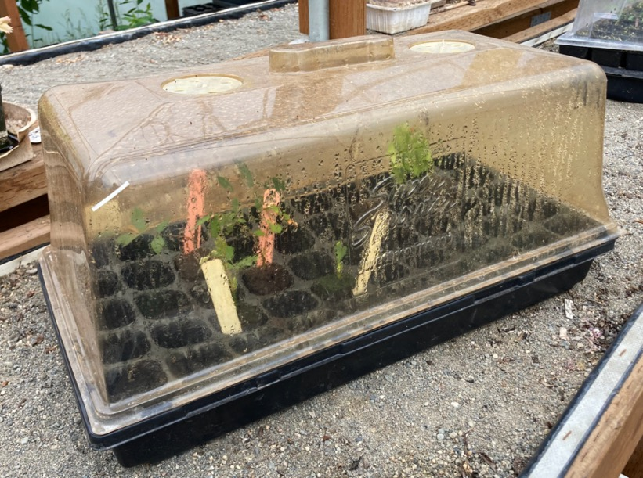
Cuttings under the Humidity Dome
The condensation inside the dome will provide most of the moisture the cutting needs, but mist leaves of cuttings every few days to maintain humidity if needed
Dome has openings that can be opened for humidity control

Slide 27
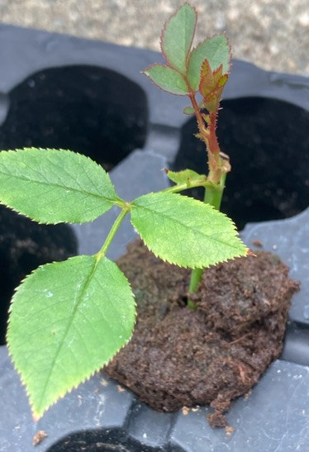
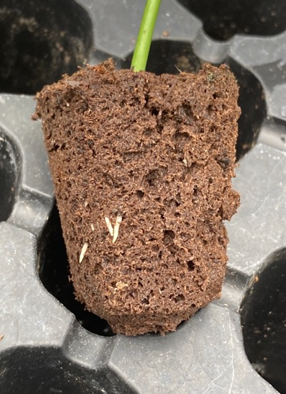
New Growth and Roots
Cuttings are rooting well – look at the new growth at the top and in the roots
This is after 10 days under the humidity dome

Slide 28
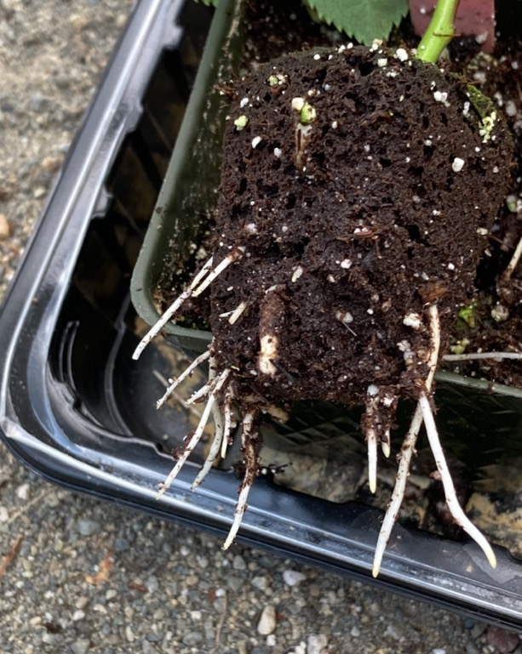
After 21 Days of Growth
Look at those nice roots!
This one can soon be transplanted to a larger container
Plant rooting cube and all – do NOT break apart
Roots are tender but they are growing thru the cube as you see here

Slide 29
Checking on the Cuttings
Most softwood rose cuttings will root within 10 to 14 days!
To check – tug very gently! You'll feel a slight resistance as the new roots form and grow into the rooting cube
Gradually expose to outside air – make holes in bag
Keep leaves well misted!
Once roots are established and plants show strong new growth, you can transplant but do NOT break apart the rooting cube – roots are very tender, but they will grow right thru it

Slide 30
Questions?
Thank You!

