Slide 1

October 20, 2024
Business meeting
Election of Officers
Program
Propagating workshop

Slide 2
Propagating
Hardwood Cuttings
Mitchie & John Moe
Master Rosarians
Pacific Northwest District
American Rose Society
Revised October 2024
November 8, 2011

Slide 3
Acknowledgements
We appreciate the efforts of the following rosarian and fellow hybridizer who contributed much of the basic procedure for this presentation;
All photos by authors except where credits are given
Please – no commercial use of this program
Steve McCulloch
Olympia Rose Society
Owner, Mountain Shadow Nursery
Past President, International Plant Propagator’s Society
Consultant – Rose Hybridizers Association

Slide 4
To Propagate
The definition of propagation is to create a new plant that is identical to the original plant.

Slide 5
U.S. Plant Patent Act
Under the law, the grant of a patent includes the “right to exclude others from asexually reproducing the plant or selling or using the plant so reproduced.” Infringement of the patent includes the propagation or sale of a single patented rose, whether for sale or private use without permission.

Slide 6
Propagation
The multiplication or reproduction of a kind or species
Via
Sexual methods
Asexual methods

Slide 7
Sexual Propagation
From seeds
Transfer of pollen from the anther of one rose to the stigma of another – this is the hybridization process
  Fertilization occurs and seeds are produced
  Every seed will produce a unique plant!

Slide 8
Asexual Reproduction
Uses growing plant parts other than the seeds
Types of asexual reproduction
    Cuttings
    Layering
    Division or separation
    Budding
    Grafting
    Tissue culture

Slide 9




Photo by Rich Baer
Photo by Corinne Brown
Seattle Sunrise
Hot To Trot
Let’s look at how we could make more of these lovelies!
Lynn
Hunker Down

Slide 10
Cuttings - Defined
Any detached plant part which, when grown under favorable conditions, will produce a new plant identical to the parent plant
Types of cuttings
Root
Leaf
Stem
We will be discussing stem cuttings in this program

Slide 11
Stem Cuttings
One of the simplest methods of propagating new roses is to cut off pieces of the stem and plant them into a growing medium, where they will take root
There are two different methods;
  Hardwood – taken in late fall or early winter
  Softwood – taken during the growing season
Let’s talk about some hardwood cuttings today!

Slide 12
Procedure
Gather materials
Obtain and label cuttings
Prepare rooting media
Prepare cuttings
Dip in rooting hormone
Place cuttings in media
Protect your cuttings
Let’s take a closer look at each step…

Slide 13
Gather Materials
Some good sterile potting soil, some Perlite, containers, plant starter rooting cubes - we did use floral foam, but prefer Root Riot® cubes now
Rooting hormone
  Rootone®, Hormodin®, Dip ‘N Grow®, Clonex®, etc. – but prefer Clonex®!
Cup, labels, marking pen/pencil
Selected healthy plants to obtain cuttings
Water and some type of protective covering
If planted in the ground (can you can leave a year?)

Slide 14
Obtain Cuttings
Take cuttings in late September – November from healthy, disease-free donor plants
Cut stems pencil sized (length and thickness)
Proportional size for minis/miniflora’s
Should have at least 3 sets of leaves
Put a label on to identify
Plunge in a bucket of water before planting

Slide 15
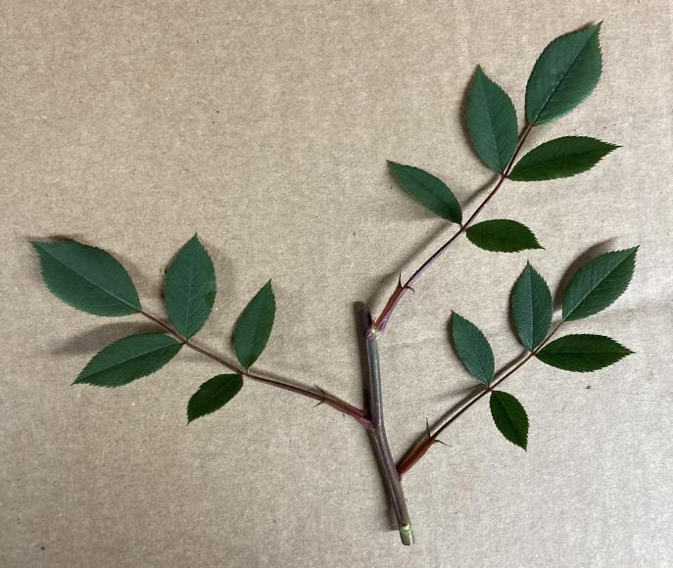
Taking Cuttings
Take cuttings from healthy plants during morning hours when they’re well hydrated
Select a cutting that has three sets of leaves
Remove the leftover bloom, cut at a 45-degree angle just above the top set of leaves
Plunge in a bucket of water
Recut under water - keep moist at all times!
Put a label/tag to ID
Note: The procedure for all roses is the same, although for minis and miniflora’s you would have a proportional size

Slide 16
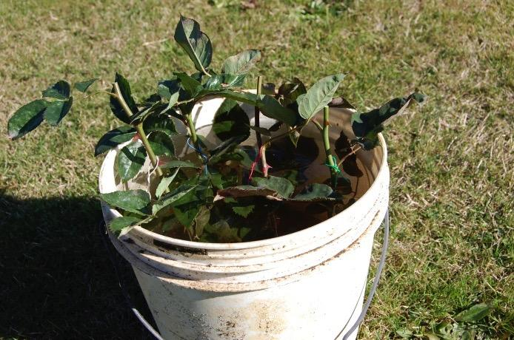
A Number of Cuttings Collected
Cuttings identified and in water

Slide 17
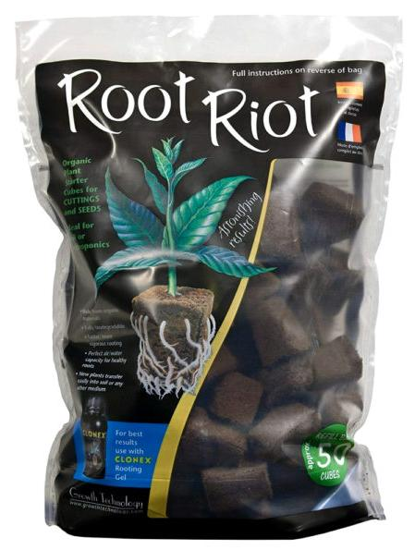
Root Riot Plant Starter Cubes
Made of fine grade Canadian peat moss
They are pH balanced and pre-moistened
They have a spongy texture that provides the ideal air to water ratio and allows them to maintain a consistent moisture level
They are specially inoculated with micro- nutrients and growth hormones to nourish young plants and aid in rapid root development

Slide 18
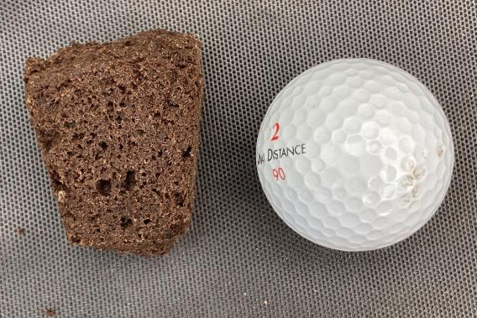
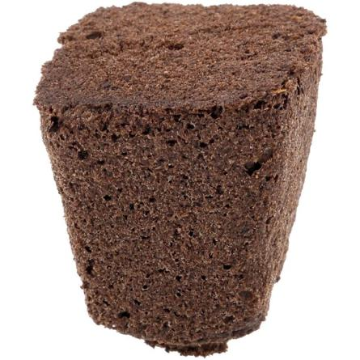
Root Riot Plant Starter Cubes
There is a small hole in the center in which to stick your cutting
Here you can see their relative size to a golf ball

Slide 19
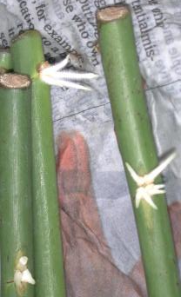
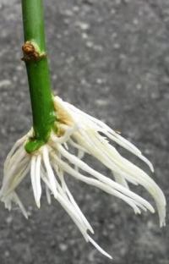
Some Technical Stuff
Most plant cuttings will produce their own rooting hormones in time. Many clone easily by placing the cutting in clean water.
Others may take a long time to develop roots without the use of a rooting hormone.
Auxin is a plant hormone that aids in the initiation of adventitious* roots. Indole-3 acetic acid (IAA) is naturally occurring in plants and affects about every aspect of plant growth. But some plants don’t produce adequate supplies of auxin and are difficult to root. Thus, we help!
Most rooting products do not contain IAA, but rather a synthetic form of indole butyric acid (IBA) and/or naphthalene acetic acid (NAA), to improve success.
*Occurring in unusual or abnormal places, e.g., roots growing on a stem

Slide 20
Rooting Hormone
Synthetic forms include powder (Rootone®, Hormodin®, etc.), liquid (Dip ‘N Grow®, Wood’s, etc.) or gels, such as Clonex®
Naturally occurring hormones include;
  Willow extract contains two auxin hormones found in high concentration in the growing tips of the branches – works as well as synthetics!
  Honey or cinnamon can protect the tender cuttings from pathogens and allow the natural rooting hormones to work

Slide 21
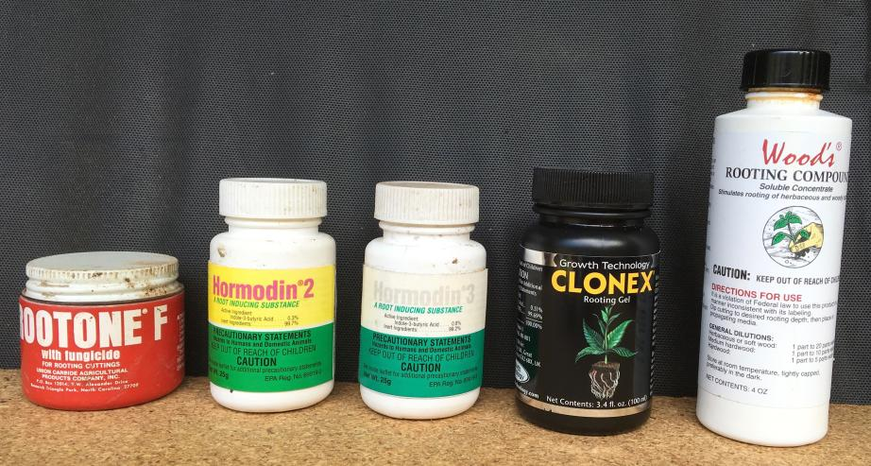
Some Rooting Hormones
.057%
.3%
.8%
.31%
1.03%
Percentage of Indole butyric acid (IBA)

Slide 22
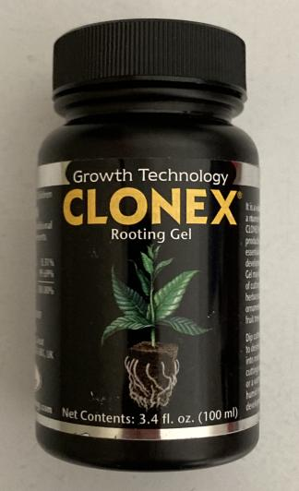
A Gel Hormone We Use
Clonex ® Rooting Gel encourages rapid root development while helping to minimize plant stress
It will remain in contact around the stem, sealing the cut tissue and then supplying the hormones needed to promote root cell development
It is registered with the EPA and is approved for use on all food crops, including medicinal plants

Slide 23
Using A Rooting Hormone
With all synthetics – put a small amount for use into a separate container to avoid contamination of the entire supply
Liquid forms can be ready-to-use or concentrated. Do as above with the ready-to-use, while the concentrated requires dilution, so it is made in a separate container
Gels have an advantage – they help seal the cut plant tissue and promote new root growth

Slide 24
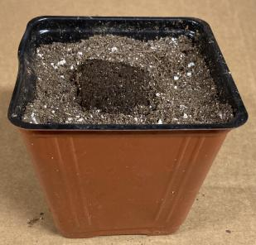
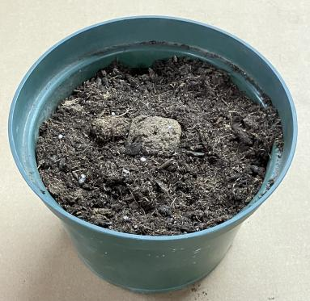
Preparing Growing Container
A 4-inch container (top) is probably big enuf for minis or miniflora’s
The 6-inch (lower) or a half gallon would work well with the larger roses
Put sterile potting mix in bottom so top of rooting cube will be just below top of container
Insert rooting cube
Fill container around rooting cube with sterile potting mix and water well
Repeat for each cutting

Slide 25
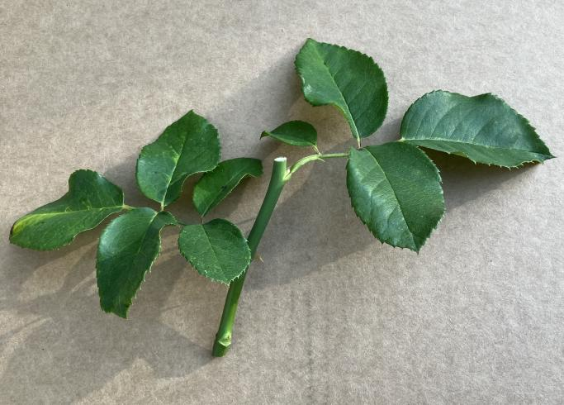
Preparing the Cutting
eye
Break off any prickles (thorns) that will be down in the rooting cube
Remove the lower set of leaves leaving two sets of leaves

Slide 26
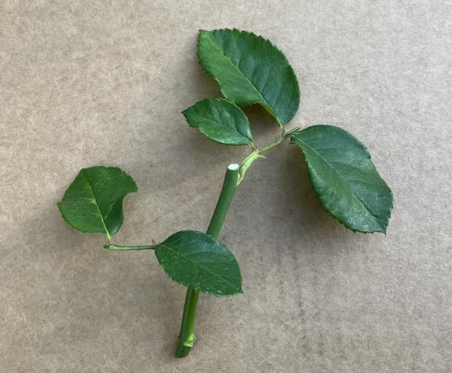
Preparing the Cutting (cont.)
eye
Reduce the leaf area by 50%
Make a 45-degree cut just below the bottom eye
Wound (scrape) lightly the stem opposite of the bottom eye
Roots will form from the wounded area

Slide 27
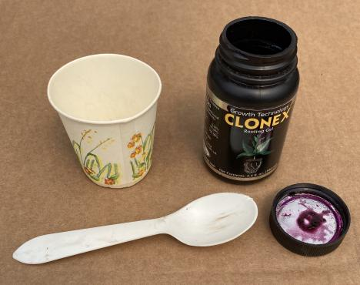
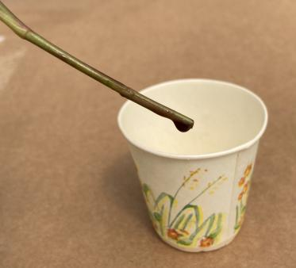
How to Use a Rooting Hormone
Dip stem in cup, not in bottle!
Discard leftover rooting hormone when finished with all cuttings
Put a small amount of rooting hormone in a small cup

Slide 28
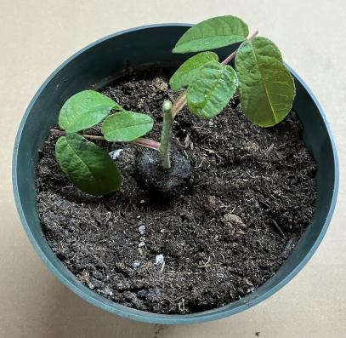
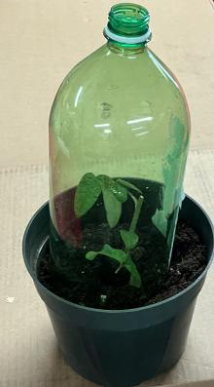
Sticking the Cutting and Covering
Gently insert cutting into the rooting cube, just far enuf so it is supported
Don’t push the stem down thru the bottom of the rooting cube
A cover helps retain moisture – use a large plastic soda bottle or a half gallon milk container

Slide 29
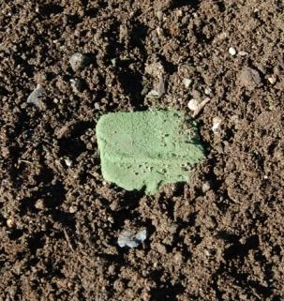
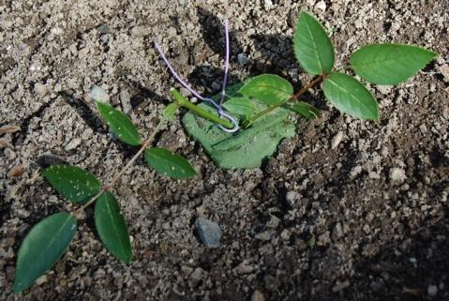
Using an Oasis or Root Riot Cube in the Ground
If using an oasis, make a small hole on top with a stick
Gently insert cutting down into the oasis or Root Riot cube, until it is supported
It should go almost to the bottom of the oasis or cube, but NOT thru it!
If using oasis, gently firm it around the stem

Slide 30
Fall and Winter Care is Also a Factor
If in containers, move to sheltered area or bury – provide adequate protection if you don’t bury!
Mulch around protective covers in cold weather
Be sure and leave the caps off!
Too much moisture inside and plants will mold!
If in containers, OK to remove in spring
If you can, leave plants alone for a year
Then you can dig and transplant

Slide 31
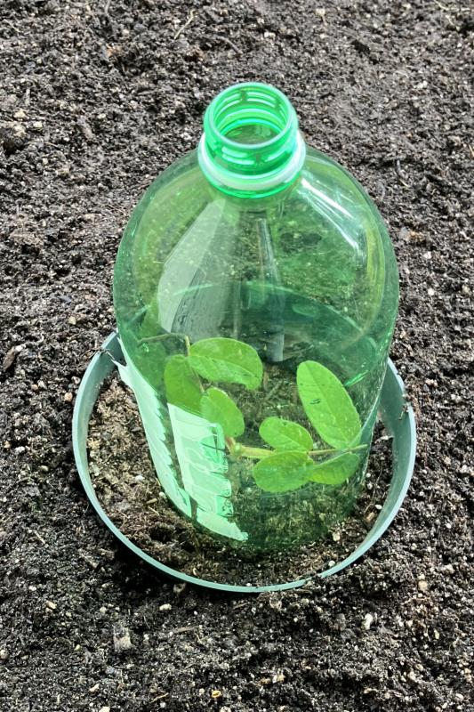
Protecting Cuttings in Containers
If you bury, bury to the rim
A cover helps retain moisture, and protects in cold weather
Leave the cap off!
Too much moisture inside and plants will mold!
Will mulch up and around the container when mulching the rest of the roses

Slide 32
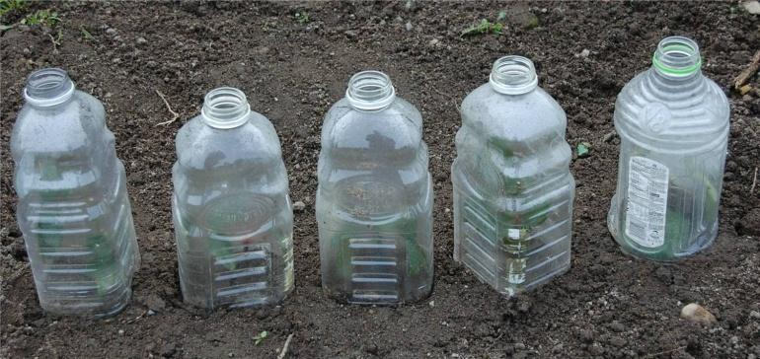
Protecting Cuttings Stuck in Ground - no containers
A cover helps retain moisture, and protects in cold weather
Be sure and leave the caps off!

Slide 33
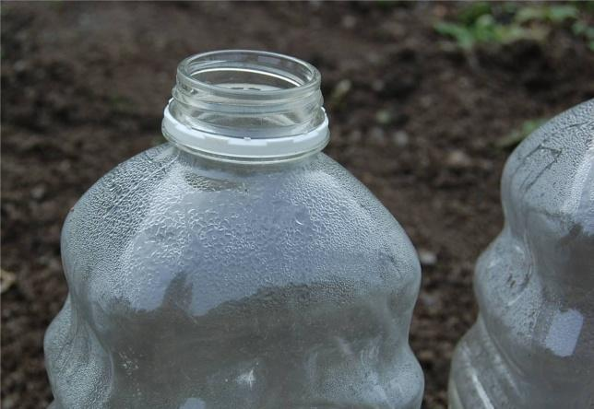
Moisture inside cover
A 50-degree overcast day!

Slide 34
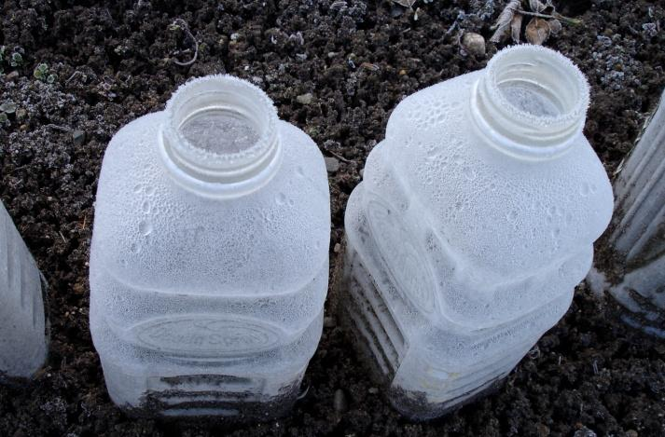
Mid-February @ 26°
Look at the frost and ice buildup from condensation the day before
Ice will melt when the sun hits it, and the moisture will run down to keep the cutting watered

Slide 35
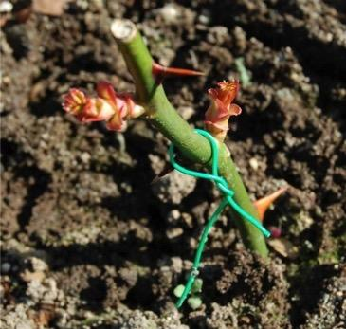
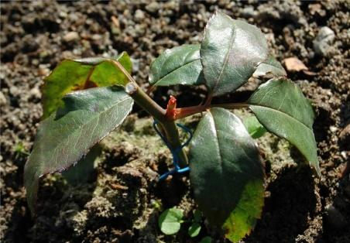
Same day in mid-Feb
Four months since planted!
Some nice new growth!
Leaves are still green with new growth in the leaf axil

Slide 36
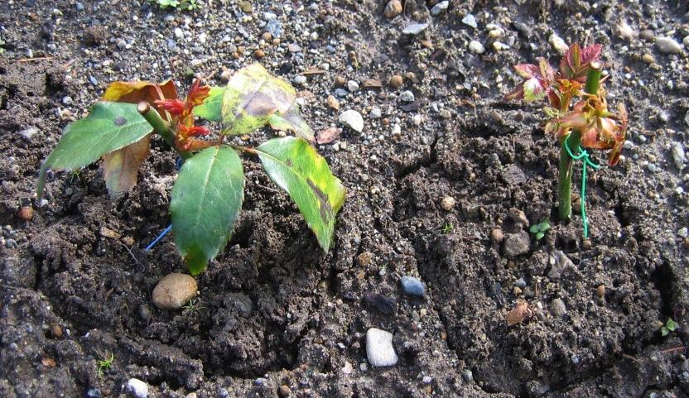
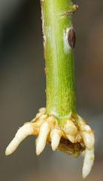
The First Day of Spring!

Slide 37
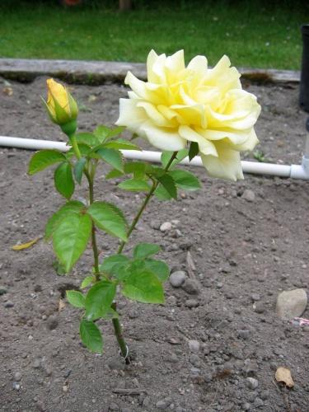
Mid June -
Eight months since planted!
4 of the 5 cuttings in this row survived and are growing
and healthy
This is the first one to bloom

Slide 38
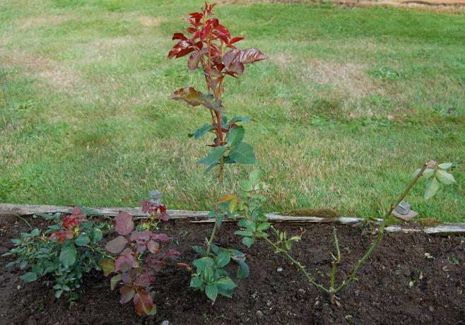
One year later
Ready for transplanting!

Slide 39
Requirements for success
Be Patient! Varies by variety
Most will root this way – give it a try!
Don’t be too hasty next spring when new growth appears
Encourage additional shoot formation and branching by removing buds
Keep well watered & fertilize normally during growing season
Let them grow the year in their temp home (best if you can)
Dig and transplant next fall
Lastly – don’t be discouraged!

Slide 40
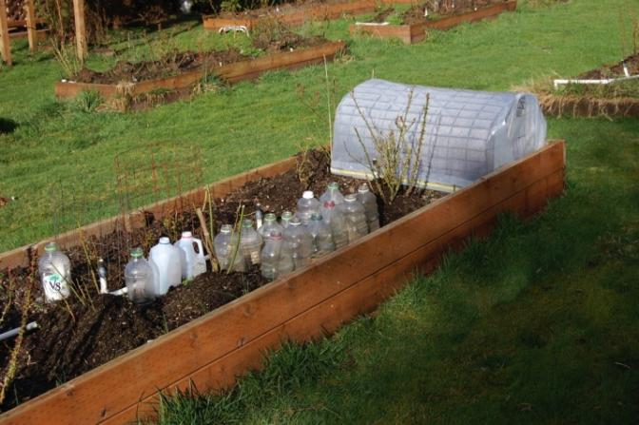
Questions?
Thank You!
Note – As you can see, there is also a larger protective cover that will cover a couple dozen plants. A wood frame covered with a fence wire hoop that is covered with plastic. This one is 2’ x 4’. It has vents on each end, but it still will get quite warm.

Slide 41
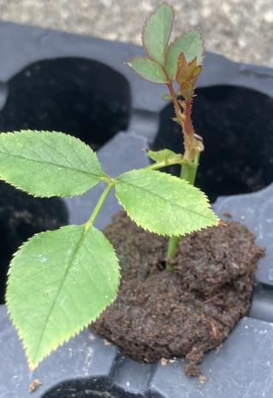
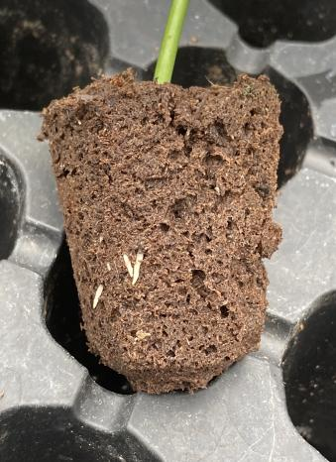
New Growth and Roots
Cuttings are rooting well – look at the new growth at the top and in the roots
This slide is from the softwood program, but the same growth would occur with the hardwood cutting, albeit not as fast

